Slide 1
ELEMENTARY STATISTICS, BLUMAN
Shapes of Distributions (Part 2 of 2)
© 2019 McGraw-Hill Education. All rights reserved. Authorized only for instructor use in the classroom. No reproduction or further distribution permitted without the prior written consent of McGraw-Hill Education.

Slide 2
Objectives for this PowerPoint
Learn how to recognize the following common shapes of distributions of data.
J-shaped
Reverse J-shaped
Bimodal-shaped
U-shaped

Slide 3
Definition of U-shaped Distribution
A U-shaped distribution has peaks on the extreme left and right, and low frequencies toward the center.

Slide 4
U-shaped Distribution (1)
This histogram shows the scores on the first attempt of a Statistics Test.
Note that the frequencies for this distribution are very low in the center and increase to right and left, with peaks on either end.

Slide 5
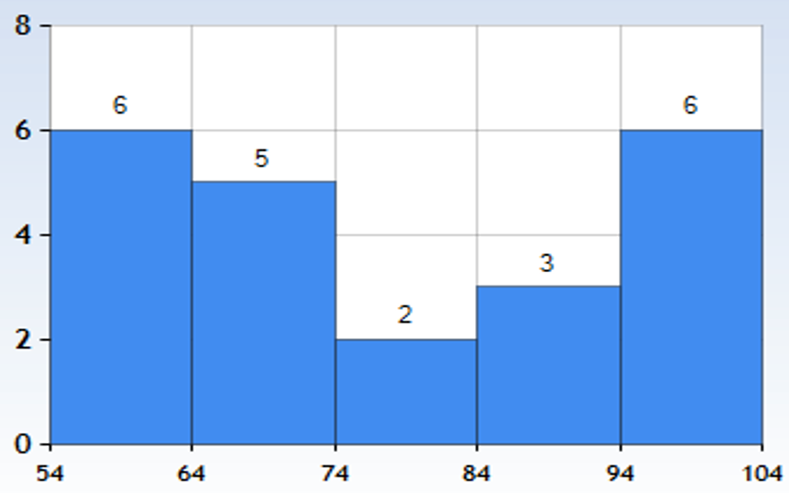
U-shaped Distribution (2)
This is an example of a U-shaped distribution.
Jump to long description

Slide 6
Definition of J-shaped Distribution
A J-shaped distribution has a few data values on the left side and increases as one moves to the right.

Slide 7
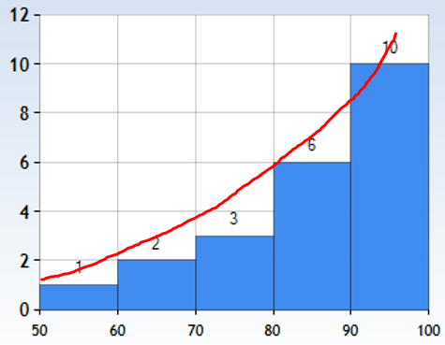
J-shaped Distribution
This histogram shows the scores on a second attempt of a statistics test.
Note that the frequencies for this distribution are very low on the left and increase toward the right with a peak in the class on the far right.
This is an example of a J-shaped distribution.
Jump to long description

Slide 8
Definition Reverse J-shaped Distribution
In this distribution, the frequencies are very low on the right and increase towards the left with a peak in the class on the far left.

Slide 9
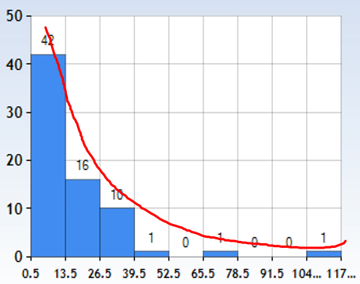
Reverse J-shaped Distribution
This histogram shows the number of guns per 100 people for 71 countries in the year 2016.
This is an example of a Reverse-J shaped distribution.
Jump to long description

Slide 10
Definition of Mode and Bimodal
The highest peak of a distribution indicates where the mode of the data values is.
The mode is the data value that occurs more often than any other data value.
When a distribution has two peaks of the same height, it is said to be bimodal.

Slide 11
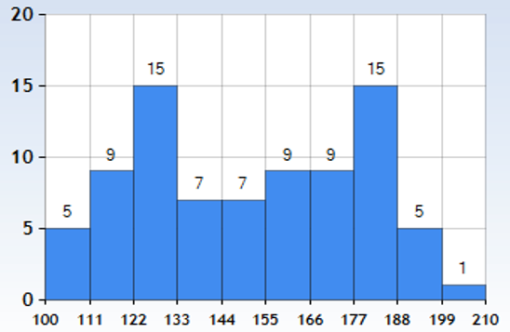
Bimodal Distribution
This histogram shows the weights of 82 members of a high school marching band.
This bimodal shape frequently occurs when two distinct groups are included in the same population. The two modes in this data set probably occur because men and women are both included.
This distribution is bimodal.
Jump to long description

Slide 12
Summary
In this PowerPoint we learned how to recognize the following common shapes of distributions of data.
U-shaped
J-shaped
Reverse J-shaped
Bimodal-shaped

Slide 13
Appendix of Image Long Descriptions

Slide 14
U-shaped Distribution - Appendix
Vertical axis from bottom to top is labeled 0, 2, 4, 6, 8.
Horizontal axis from left to right is labeled 54, 4, 74, 84, 94, 104.
Heights of bars from left to right are 6, 5, 2, 3, 6.
Jump to the image

Slide 15
J-shaped Distribution - Appendix
Vertical axis is labeled from bottom to top as 0, 2, 4, 6, 8, 10, 12
Horizontal axis is labeled from left to right as 50, 60, 70, 80, 90, 100
Heights of bars from left to right are 1, 2, 3, 6, 10
Jump to the image

Slide 16
Reverse J-shaped Distribution - Appendix
Vertical axis from bottom to top is labeled as 0, 10, 20, 30, 40, 50
Horizontal axis from left to right is labeled .5, 13.5, 26.5, 39.5, 52.5, 65.5, 78.5, 91.5 104.5, 117.5
The heights of the bars from left to right are 42, 16, 10, 1, 0, 1, 0, 0, 1
Jump to the image

Slide 17
Bimodal Distribution - Appendix
Vertical axis from bottom to top is labed 0, 5, 10, 15, 20.
Horizontal axis from left to right is labeled 100, 111, 122, 133, 144, 155, 166, 177, 188, 199, 210.
The heights of the bars from left to right are 5, 9, 15, 7, 7, 9, 9, 15, 5, 1
Jump to the image

